Slide 1

Motor Vehicle Accidents: South Australia 2019
Mini Project 2
By Matt Hacket

Slide 2
Business Question:
Can I classify the factors that contribute to motor vehicle accidents causing injury?
Background Information:

Slide 3
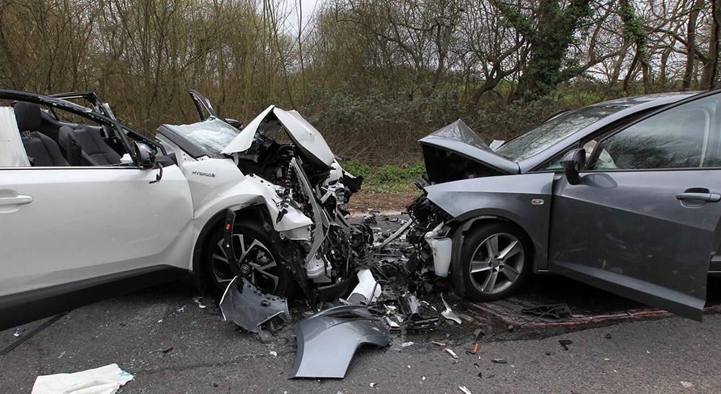
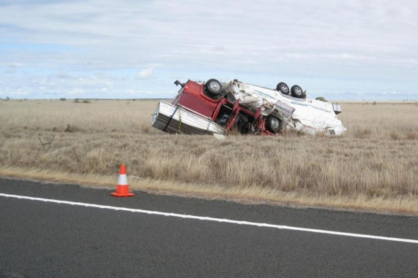
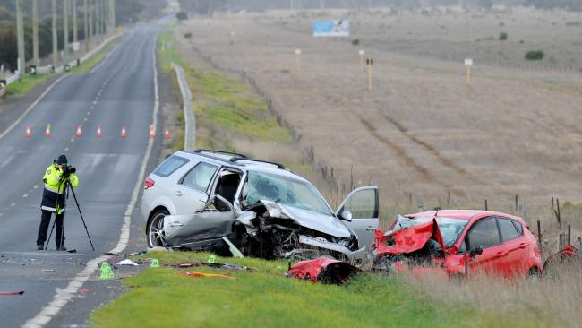
Cost of Motor Vehicle Accidents in Australia
A 2017 study from the Australian Automobile Association has found that:
Total cost of road trauma = $22.2b
The economic cost of each road fatality was $4.34m
The cost per hospitalisation was $239,000

Slide 4
Data Pipeline
Data Acquisition
Business Question formulation
Data Cleaning/munging
Visualisation
Modelling
Interpretation

Slide 5
Data Pipeline
More data acquisition (pd.merge)
Data Cleaning/munging (80%)
Visualisation
Modelling
Interpretation

Slide 6
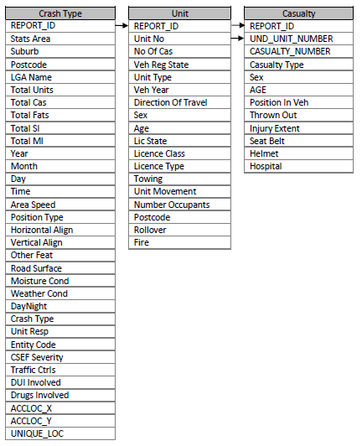
Data
3 datasets comprising all info
2 datasets merged/used
‘Crash Type’
(12964, 33)
‘Unit’
(27713, 13)
Final
50 features
12964 observations

Slide 7
Data
50 features
18 features with null values
12 features with ‘Unknown’ values
Feature engineering
Imputing null/unknown values
Veh_year to veh_age
Binary classification of yes/no features (raining/daytime etc)
Target encoding of categorical features
Ensure all features are numerical

Slide 8
Final Data
30 features
2 continuous features (Age, Vehicle Age)
4 Target encoded (Cardinal Categorical)
13 Label encoding (Ordinal Categorical)
10 Binary (excl. target = Casualty (yes/no)

Slide 9
Final Data – Target
Casualty feature (assumed balanced data)
0: 0.64
1: 0.36
Classified as:
Injuries as a result of vehicular accident that results in:
MI: Minor Injury
SI: Serious Injury – hospitalisation
Fatality
Crashes without casualties?
Property damage only

Slide 10
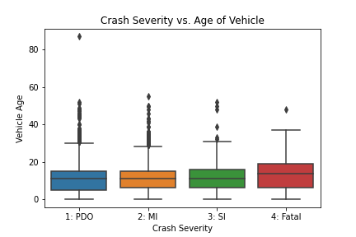
Factors Involved in Crash Severity
Slight increase for vehicle age and crash severity

Slide 11
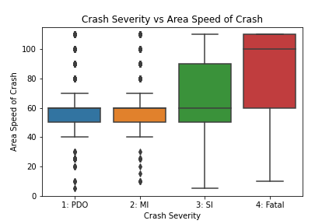
Factors Involved in Crash Severity
Large increase for area speed and incidents resulting in fatalities

Slide 12

Modelling Results
 | Accuracy | Recall | F-Score
Logistic Reg | 0.67 | 0.17 | 0.78
SVM Linear | 0.66 | 0.17 | 0.78
Naïve Bayes | 0.66 | 0.25 | 0.77
All models within <1% of test/train scores

Slide 13
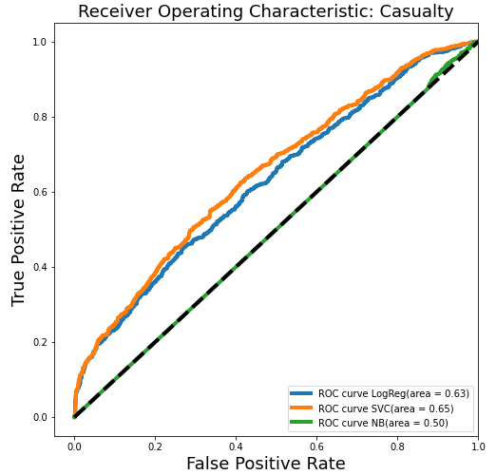
Receiver Operating Characteristic
Support Vector Machines performed the best, according to the Receiver Operating Characteristics curve – reducing the amount of false positives while counting true positives.

Slide 14
Modelling Results
 | Accuracy | Recall | F-Score
Logistic Reg | 0.66 | 0.17 | 0.78
SVM Linear | 0.66 | 0.17 | 0.78
Naïve Bayes | 0.66 | 0.25 | 0.77
All models within <1% of test/train scores

Slide 15
Summary
All models performed about the same on accuracy
Linear Support Vector Machines model was able to be chosen based on ROC graph
Naïve Bayes had a similar accuracy, better recall rate but performed worse on the ROC curve

Slide 16
Limitations/Further Investigations
Another dataset to merge in which may provide further information in modelling
Feature Selection algorithms should be used for future investigations into this dataset i.e Random Forest
I may have been ‘blinded’ by including too many features in the final model
‘Unit Responsible’ feature was not included from the third dataset – could provide interesting information regarding the demographic of drivers causing crashes
Multiple units involved in crashes not included in current investigation

Slide 17
THANKS!
ANY QUESTIONS?

Slide 18
References
Cost of Road Trauma in Australia – Summary Report 2017: Australian Automobile Association
Data taken from data.sa.gov.au

